Slide 1

C# Advanced – Class 10
Trainer: Igor Micev
Assistant: Martin Panovski
Code academy @ Skopje, 2019

Slide 2
Agenda
Exceptions
Nuget package manager
Serialization/Deserialization - Introduction
Input and Output
Working with Text files
Working with Csv files
Working with Json files
Working with Xml files

Slide 3
Exceptions
An exception is a problem that arises during the execution of a program. A C# exception is a response to an exceptional circumstance that arises while a program is running, such as an attempt to divide by zero.
Exceptions provide a way to transfer control from one part of a program to another. C# exception handling is built upon four keywords: try, catch, finally, and throw.
try: A try block identifies a block of code for which particular exceptions is activated. It is followed by one or more catch blocks.
catch: A program catches an exception with an exception handler at the place in a program where you want to handle the problem. The catch keyword indicates the catching of an exception.
finally: The finally block is used to execute a given set of statements, whether an exception is thrown or not thrown. For example, if you open a file, it must be closed whether an exception is raised or not.
throw: A program throws an exception when a problem shows up. This is done using a throw keyword.

Slide 4
Exception classes
Exception Class | Description
System.IO.IOException | Handles I/O errors.
System.IndexOutOfRangeException | Handles errors generated when a method refers to an array index out of range.
System.ArrayTypeMismatchException | Handles errors generated when type is mismatched with the array type.
System.NullReferenceException | Handles errors generated from referencing a null object.
System.DivideByZeroException | Handles errors generated from dividing a dividend with zero.
System.InvalidCastException | Handles errors generated during typecasting.
System.OutOfMemoryException | Handles errors generated from insufficient free memory.
System.StackOverflowException | Handles errors generated from stack overflow.

Slide 5
Exceptions
Demo1
Demo2

Slide 6
System.IO classes
The System.IO namespace contains types that allow reading and writing to files and data streams, and types that provide basic file and directory support.
Overview in https://docs.microsoft.com/en-us/dotnet/api/system.io?view=netframework-4.7.2

Slide 7
Working with text files
The System.IO namespace contains types that allow reading and writing to files and data streams, and types that provide basic file and directory support.
The File class methods ReadAllText and WriteAllText:
ReadAllText(String, Encoding) | Opens a file, reads all text in the file with the specified encoding, and then closes the file.
ReadAllText(String) | Opens a text file, reads all the text in the file, and then closes the file.
WriteAllText(String, String) | Creates a new file, writes the specified string to the file, and then closes the file. If the target file already exists, it is overwritten.
WriteAllText(String, String, Encoding) | Creates a new file, writes the specified string to the file using the specified encoding, and then closes the file. If the target file already exists, it is overwritten.

Slide 8
Working with text files
Demo
Other most used methods (https://docs.microsoft.com/en-us/dotnet/api/system.io.file?view=netframework-4.7.2):
Create
CreateText
AppendText / AppendAllText
Delete
Move
ReadLines / ReadAllLines
WriteAllLines

Slide 9
Nuget package manager
Demo
Add the CsvHelper to a project.

Slide 10
Working with Csv files
CsvHelper - A library for reading and writing CSV files. Extremely fast, flexible, and easy to use. Supports reading and writing of custom class objects.
https://www.nuget.org/packages/CsvHelper
Install-Package CsvHelper -Version 12.1.2
CsvReader class
GetRecords() method
CsvWriter class
WriteRecords() method
Demo

Slide 11
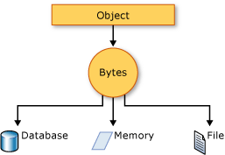
Serialization
Serialization is the process of converting an object into a stream of bytes to store the object or transmit it to memory, a database, or a file. Its main purpose is to save the state of an object in order to be able to recreate it when needed. The reverse process is called deserialization.

Slide 12
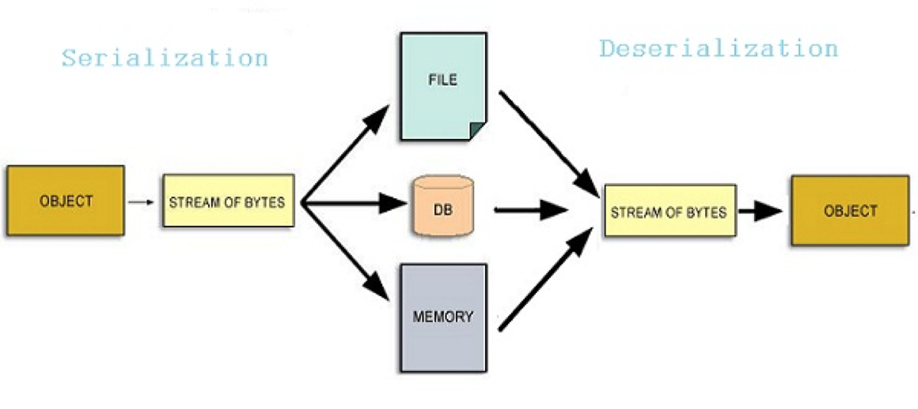
Deserialization
Deserialization is the opposite process of Serialization

Slide 13
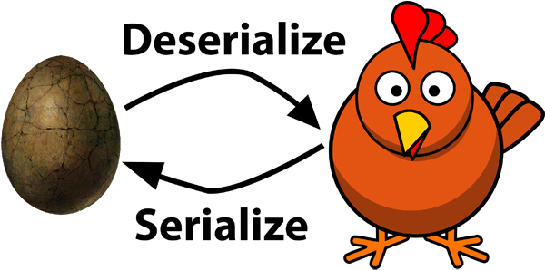
Serialize and Deserialize

Slide 14
Nuget package Newtonsoft
Json.NET is a popular high-performance JSON framework for .NET
https://www.nuget.org/packages/Newtonsoft.Json/
using Newtonsoft.Json;
using Newtonsoft.Json.Linq;
Working with JSON:
Creating JSON and writing to JSON file
Reading JSON from file
Writing a collection into JSON file
Writing JSON array with Jarray to JSON file

Slide 15
Working with XML
System.Xml.Linq - Contains the classes for LINQ to XML. LINQ to XML is an in-memory XML programming interface that enables you to modify XML documents efficiently and easily.
https://docs.microsoft.com/en-us/dotnet/api/system.xml.linq?view=netframework-4.7.2
Demo
Reading XML file with XDocument
Reading Customers file based on Customer class
Reading Orders file based on Order class
Reading Products file based on Product class

